Slide 1
Owl-M:
A Material Design Study App
Team members:
Arun.p.k
Arulkumarn A
Chanduru
Kishore

Slide 2
Project Description
A project that demonstrates the use of Android Jetpack Compose to build a UI for a Owl-M: a material design study app. Owl-M app is a sample project built using the Android Compose UI toolkit. A Compose implementation of the Owl Material study.

Slide 3
Source code
<vector xmlns:android="http://schemas.android.com/apk/res/android" xmlns:aapt="http://schemas.android.com/aapt" android:width="108dp" android:height="108dp" android:viewportWidth="108" android:viewportHeight="108"> <path android:pathData="M31,63.928c0,0 6.4,-11 12.1,-13.1c7.2,-2.6 26,-1.4 26,-1.4l38.1,38.1L107,108.928l-32,-1L31,63.928z"> <aapt:attr name="android:fillColor"> <gradient android:endX="85.84757" android:endY="92.4963" android:startX="42.9492" android:startY="49.59793" android:type="linear"> <item android:color="#44000000" android:offset="0.0" /> <item android:color="#00000000" android:offset="1.0" /> </gradient> </aapt:attr> </path> <path android:fillColor="#FFFFFF" android:fillType="nonZero"

Slide 4
android:pathData="M65.3,45.828l3.8,-6.6c0.2,-0.4 0.1,-0.9 -0.3,-1.1c-0.4,-0.2 -0.9,-0.1 -1.1,0.3l-3.9,6.7c-6.3,-2.8 -13.4,-2.8 -19.7,0l-3.9,-6.7c-0.2,-0.4 -0.7,-0.5 -1.1,-0.3C38.8,38.328 38.7,38.828 38.9,39.228l3.8,6.6C36.2,49.428 31.7,56.028 31,63.928h46C76.3,56.028 71.8,49.428 65.3,45.828zM43.4,57.328c-0.8,0 -1.5,-0.5 -1.8,-1.2c-0.3,-0.7 -0.1,-1.5 0.4,-2.1c0.5,-0.5 1.4,-0.7 2.1,-0.4c0.7,0.3 1.2,1 1.2,1.8C45.3,56.528 44.5,57.328 43.4,57.328L43.4,57.328zM64.6,57.328c-0.8,0 -1.5,-0.5 -1.8,-1.2s-0.1,-1.5 0.4,-2.1c0.5,-0.5 1.4,-0.7 2.1,-0.4c0.7,0.3 1.2,1 1.2,1.8C66.5,56.528 65.6,57.328 64.6,57.328L64.6,57.328z" android:strokeWidth="1" android:strokeColor="#00000000" /></vector>

Slide 5
<?xml version="1.0" encoding="utf-8"?><vector xmlns:android="http://schemas.android.com/apk/res/android" android:width="108dp" android:height="108dp" android:viewportWidth="108" android:viewportHeight="108"> <path android:fillColor="#3DDC84" android:pathData="M0,0h108v108h-108z" /> <path android:fillColor="#00000000" android:pathData="M9,0L9,108" android:strokeWidth="0.8" android:strokeColor="#33FFFFFF" /> <path android:fillColor="#00000000" android:pathData="M19,0L19,108" android:strokeWidth="0.8" android:strokeColor="#33FFFFFF" /> <path android:fillColor="#00000000" android:pathData="M29,0L29,108" android:strokeWidth="0.8" android:strokeColor="#33FFFFFF" /> <path android:fillColor="#00000000" android:pathData="M39,0L39,108" android:strokeWidth="0.8" android:strokeColor="#33FFFFFF" /> <path android:fillColor="#00000000" android:pathData="M49,0L49,108" android:strokeWidth="0.8" android:strokeColor="#33FFFFFF" /> <path android:fillColor="#00000000" android:pathData="M59,0L59,108" android:strokeWidth="0.8"

Slide 6
android:strokeColor="#33FFFFFF" /> <path android:fillColor="#00000000" android:pathData="M0,59L108,59" android:strokeWidth="0.8" android:strokeColor="#33FFFFFF" /> <path android:fillColor="#00000000" android:pathData="M0,69L108,69" android:strokeWidth="0.8" android:strokeColor="#33FFFFFF" /> <path android:fillColor="#00000000" android:pathData="M0,79L108,79" android:strokeWidth="0.8" android:strokeColor="#33FFFFFF" /> <path android:fillColor="#00000000" android:pathData="M0,89L108,89" android:strokeWidth="0.8" android:strokeColor="#33FFFFFF" /> <path android:fillColor="#00000000" android:pathData="M0,99L108,99" android:strokeWidth="0.8" android:strokeColor="#33FFFFFF" /> <path android:fillColor="#00000000" android:pathData="M19,29L89,29" android:strokeWidth="0.8" android:strokeColor="#33FFFFFF" /> <path android:fillColor="#00000000"

Slide 7
android:pathData="M19,39L89,39" android:strokeWidth="0.8" android:strokeColor="#33FFFFFF" /> <path android:fillColor="#00000000" android:pathData="M19,49L89,49" android:strokeWidth="0.8" android:strokeColor="#33FFFFFF" /> <path android:fillColor="#00000000" android:pathData="M19,59L89,59" android:strokeWidth="0.8" android:strokeColor="#33FFFFFF" /> <path android:fillColor="#00000000" android:pathData="M19,69L89,69" android:strokeWidth="0.8" android:strokeColor="#33FFFFFF" /> <path

Slide 8
android:fillColor="#00000000" android:pathData="M19,79L89,79" android:strokeWidth="0.8" android:strokeColor="#33FFFFFF" /> <path android:fillColor="#00000000" android:pathData="M29,19L29,89" android:strokeWidth="0.8" android:strokeColor="#33FFFFFF" /> <path android:fillColor="#00000000" android:pathData="M39,19L39,89" android:strokeWidth="0.8" android:strokeColor="#33FFFFFF" /> <path android:fillColor="#00000000" android:pathData="M49,19L49,89" android:strokeWidth="0.8" android:strokeColor="#33FFFFFF" /> <path android:fillColor="#00000000" android:pathData="M59,19L59,89" android:strokeWidth="0.8" android:strokeColor="#33FFFFFF" /> <path android:fillColor="#00000000" android:pathData="M69,19L69,89" android:strokeWidth="0.8" android:strokeColor="#33FFFFFF" /> <path android:fillColor="#00000000" android:pathData="M79,19L79,89" android:strokeWidth="0.8" android:strokeColor="#33FFFFFF" /></vector>

Slide 9
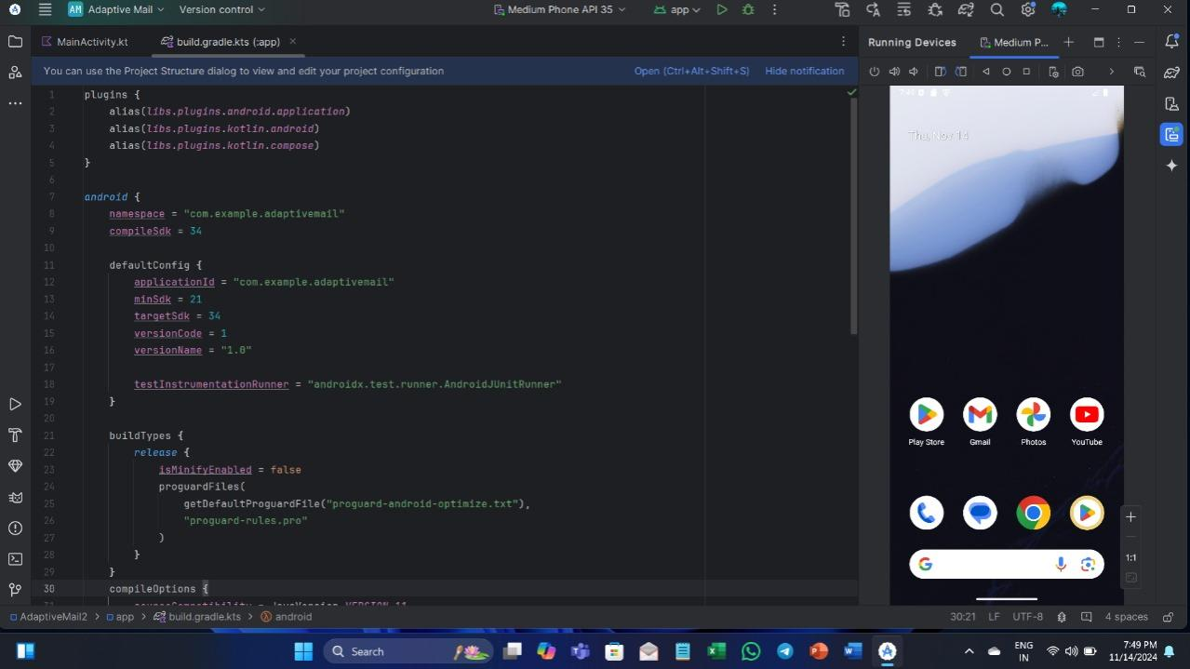
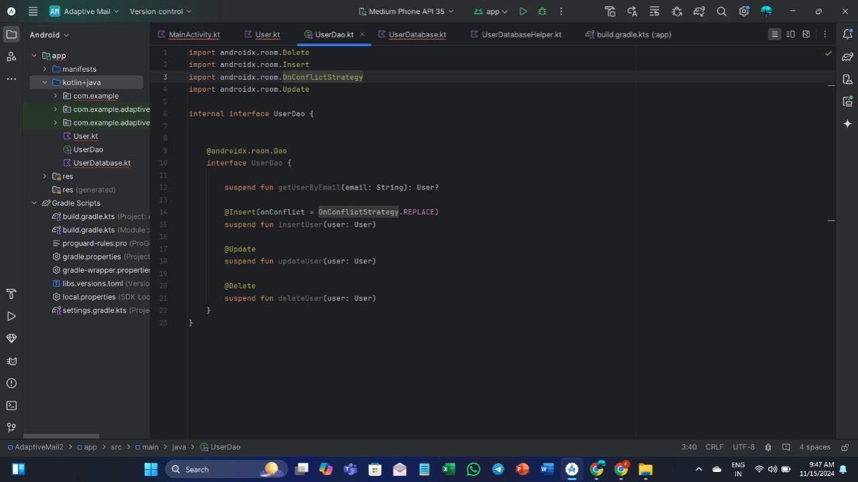
OUTPUT:

Slide 10
